Slide 1

Cluster Analysis on Spotify Data

Slide 2
INDEX
Problem Statement
Dataset Introduction
Data Analysis and Exploration
Clustering - Hierarchical, K-means
Genre Prediction - Random Forest, Naive Bayes Classifier, KNN

Slide 3
Problem Statement
Music has remained an essential component of our daily lives for centuries.Over time, our methods for listening to them have also changed.Spotify currently holds the top position with a base of more than 100 million subscribers and a market share of more than 36% among online music subscribers.As a result, examining the Spotify song database more thoroughly for interesting trends pertaining to the songs and their artists

Slide 4
Dataset Introduction
Source : Kaggle
The dataset includes Spotify's most popular music tracks from 2010 to 2019.It has 603 rows and 14 columns of data.

Slide 5
The Dataset
Column Name | Data Type | Description
Title | Character | Name of the Song
Artist | Character | Name of the Artist who composed the song
Genre | Character | Genre of the track
Year | Integer | Release year of the track
Tempo | Numeric | Beats per minute
Energy | Numeric | Energy level of the song

Slide 6
Danceability | Numeric | Danceability, easier to dance if the value is higher
Loudness | Numeric | Loudness of the song
Liveness | Numeric | Likeliness of Live recording of the song
Valence | Numeric | Describes the musical positiveness conveyed by the track
Duration | Numeric | Length of the song
Acousticness | Numeric | Acoustic Ness of the track
Speechiness | Numeric | Amount of spoken words in the song
Popularity | Numeric | Popularity of the song

Slide 7
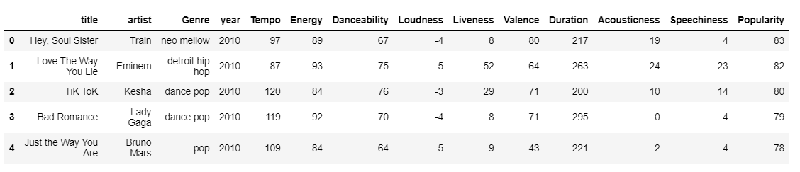
Preview

Slide 8
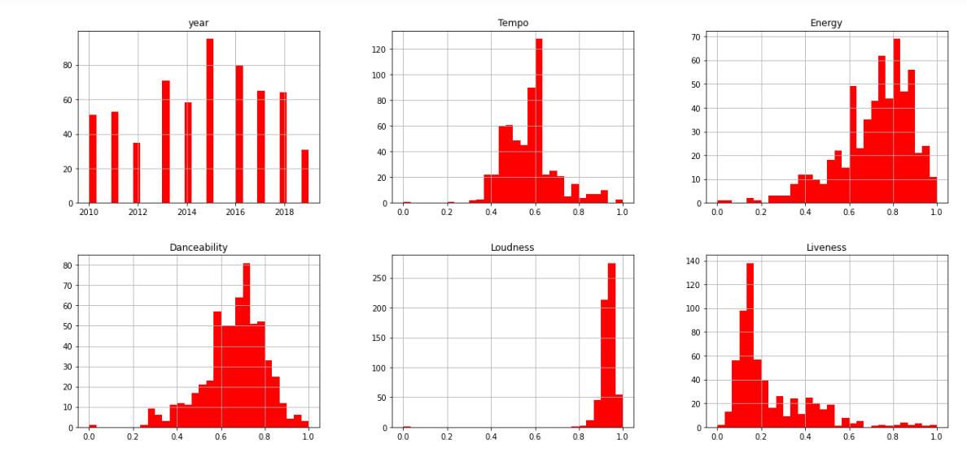
Data Analysis - Histogram
Below attached histograms depict the distribution of variables like year, tempo, energy, danceability etc

Slide 9
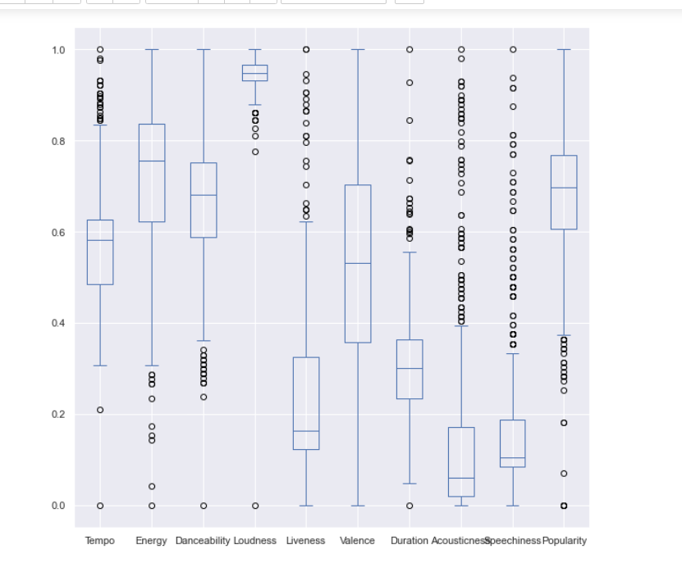
Boxplot
Used boxplot to detect outliers and below attached snippet shows outliers of each variable.

Slide 10
Report
https://dataminingprojectspotify.000webhostapp.com/

Slide 11
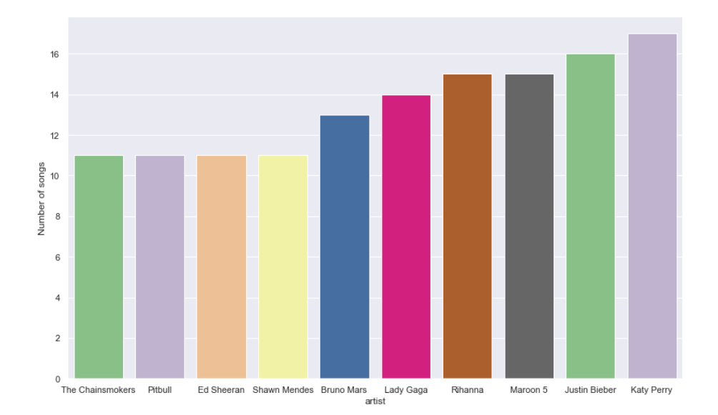
Top 10 artists who produced most number of songs
By analysing data of the artists and number of songs released by the artist, we figured out that katy perry has produced the highest no of songs.

Slide 12
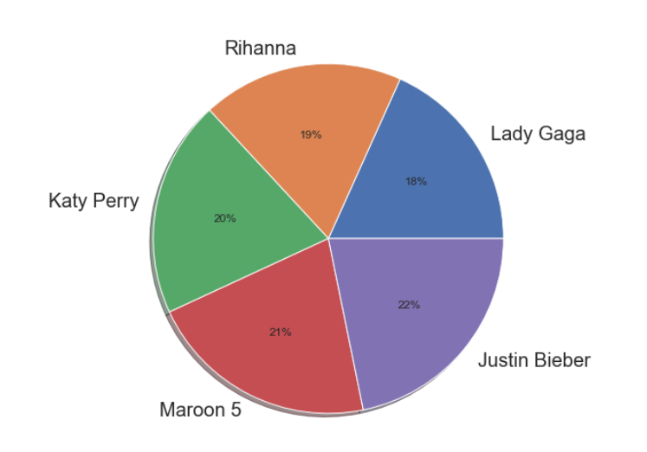
Top 5 artists based on popularity factor
By analysis data of artists and their popularity score, we figured out that Justin Bieber is the most popular artist with 22% popularity rate. Closely followed by Maroon 5 at 21%

Slide 13
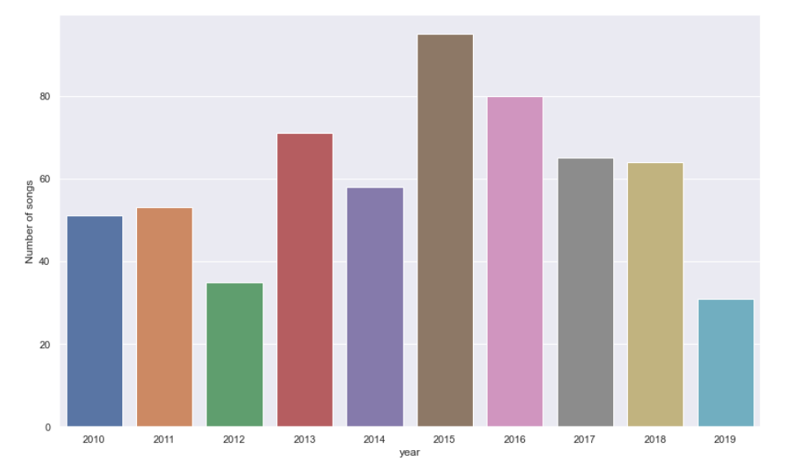
Number of tracks produced in each year
By analysing the data of number of songs released by artists each year, we figured out that in the year 2015 highest number of songs were released.

Slide 14
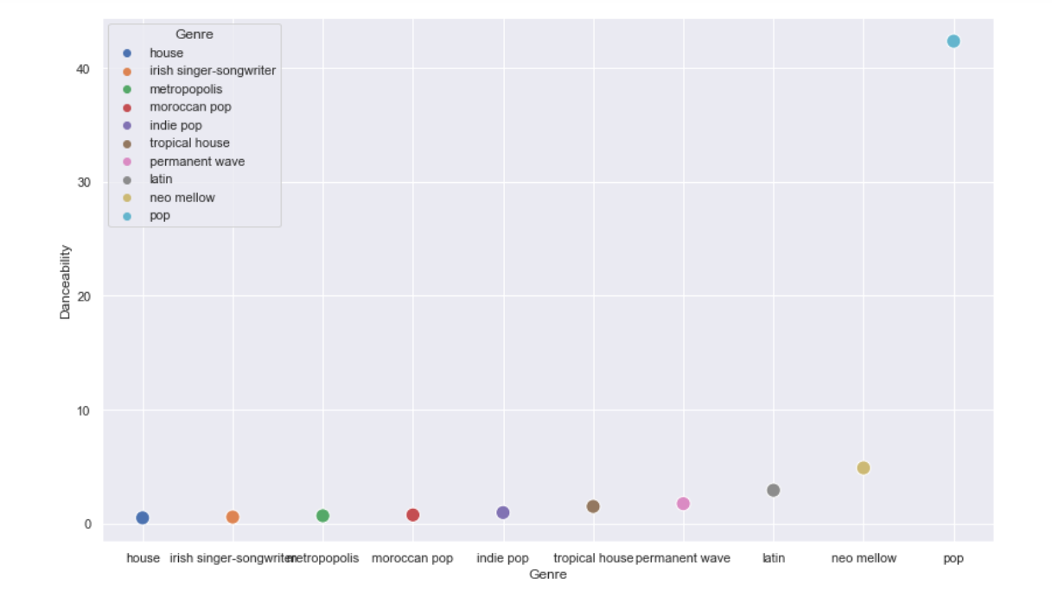
Top 10 genres based on danceability factor
By analysing data on genre and danceability score of songs of that genre, we figured out that pop genre music has the highest danceability factor and house genre music has the least danceability factor.

Slide 15
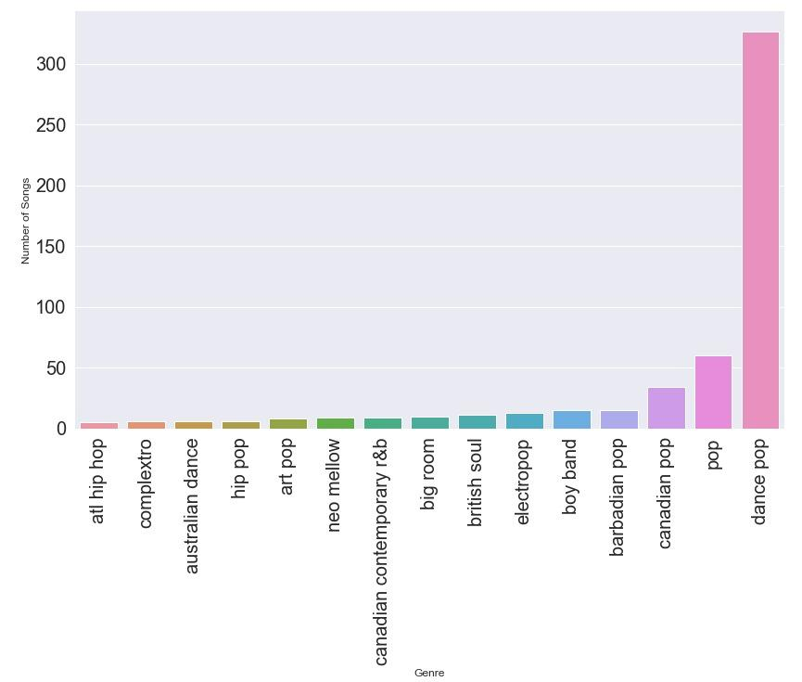
Popular Genre based on number of tracks
By analysing data based of number of songs released in particular genres, we figured out that dance pop has the highest number of songs that were released.

Slide 16
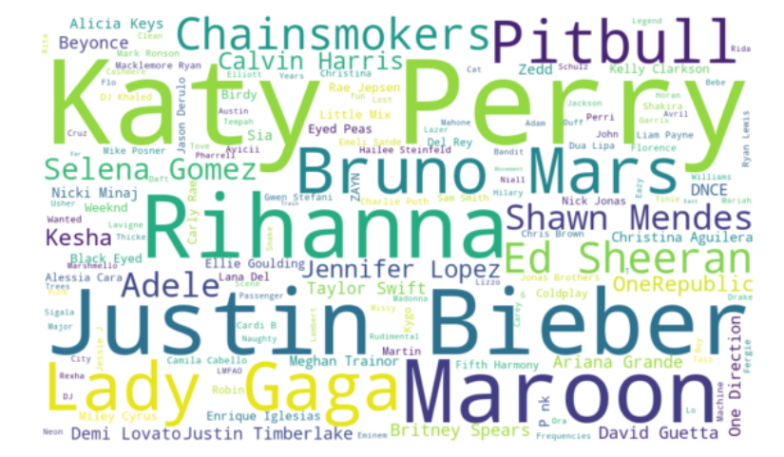
Word cloud - most frequently featured artists

Slide 17
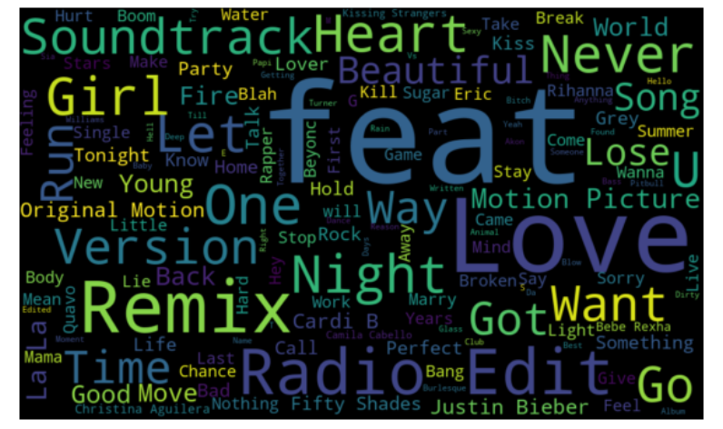
Word Cloud - most used words in popular song titles

Slide 18
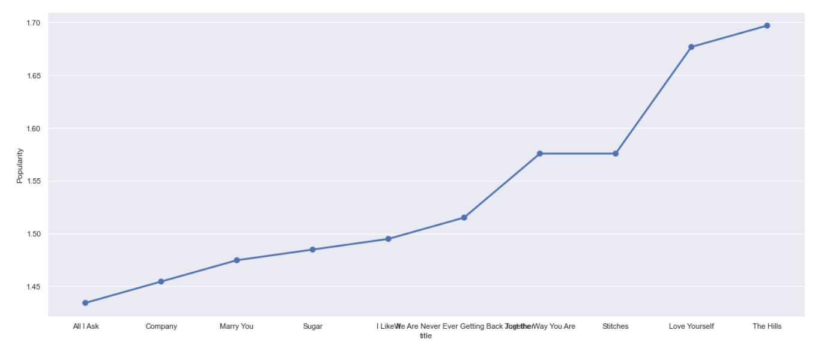
Top 10 songs based on popularity
By using the popularity score of the songs released by the artists we figured out that the songs ‘The Hills’ is the most popular song.

Slide 19
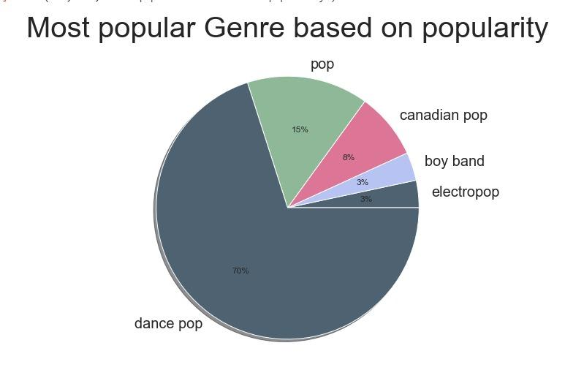
Most Popular Genre based on Popularity score
By analysing data of genre and popularity score of the songs released by the artist we figured out that Dance Pop is the most popular genre with 70% popularity rate.

Slide 20
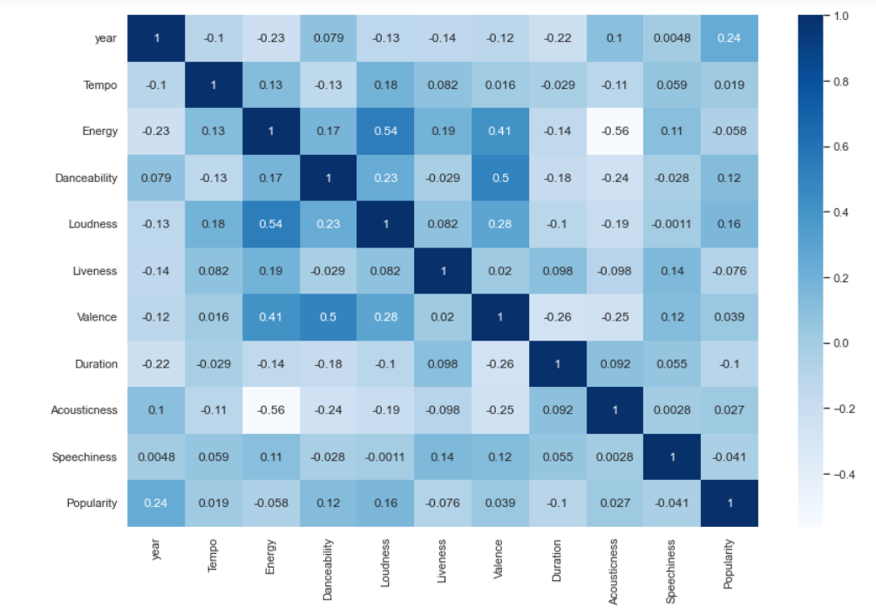
Correlation Plot between the variables
By seeing the below attached correlation plot we can understand that energy and loudness are directly related , whereas energy and acousticness are inversely related

Slide 21
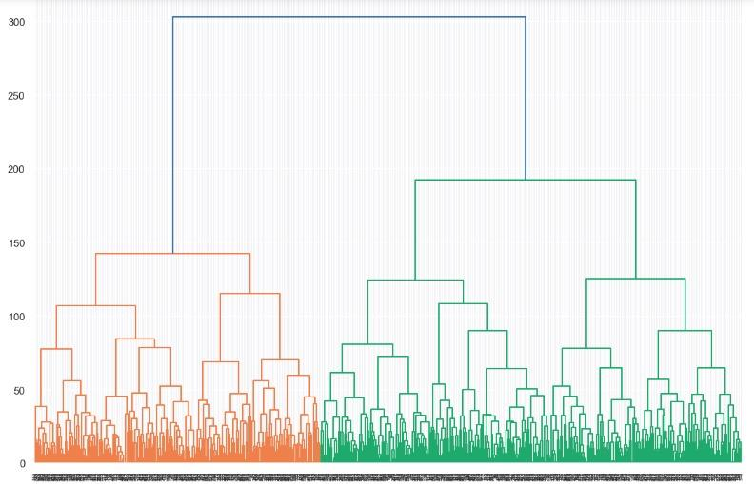
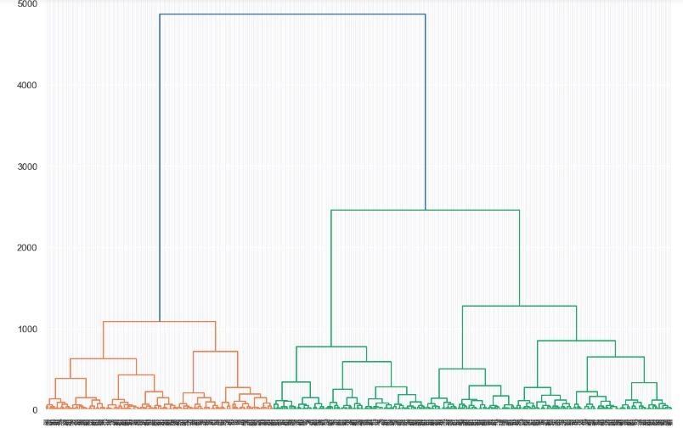
Hierarchical Clustering - Dendograms

Slide 22
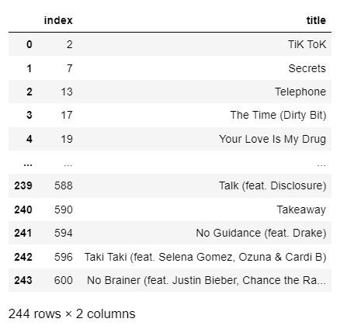
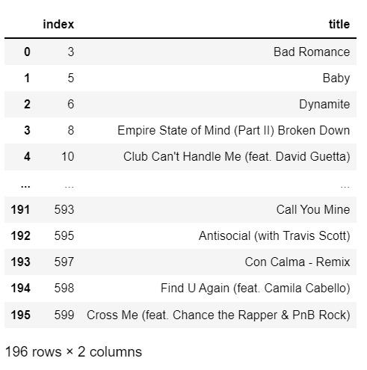
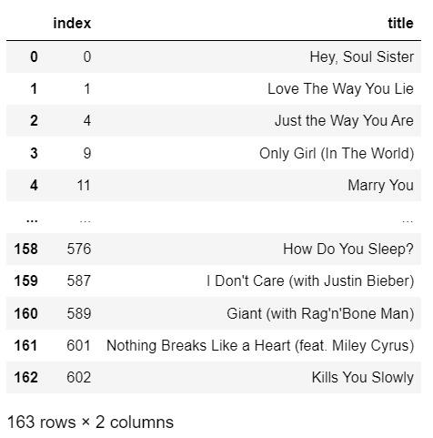
Hierarchical Clustering using Average method
Average method : Distance between two clusters is given by average distance between all pairs of objects in the clusters.

Slide 23
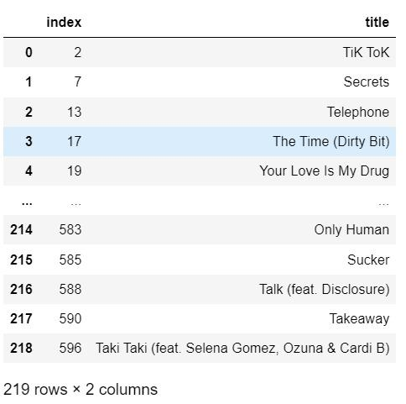
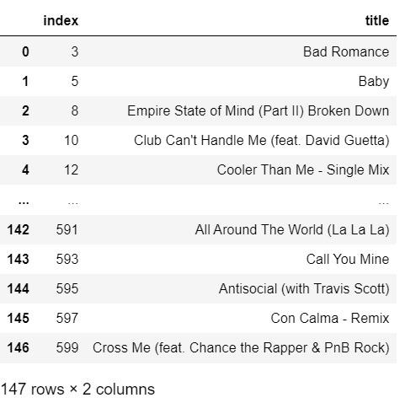
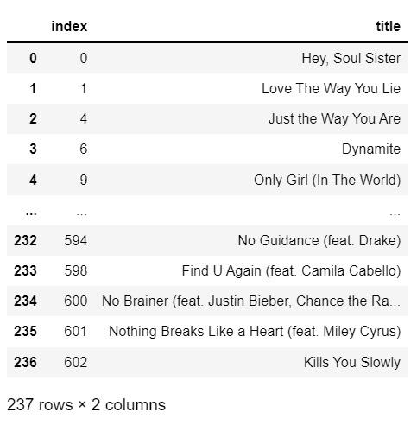
Hierarchical Clustering using Ward Method
Ward Method : considers cluster analysis as an analysis of variance problem. Agglomerative clustering is used in this technique.

Slide 24
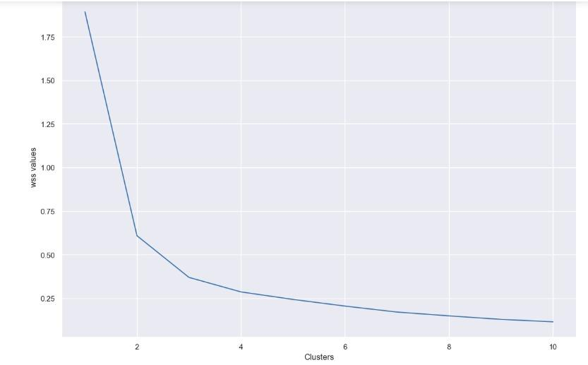
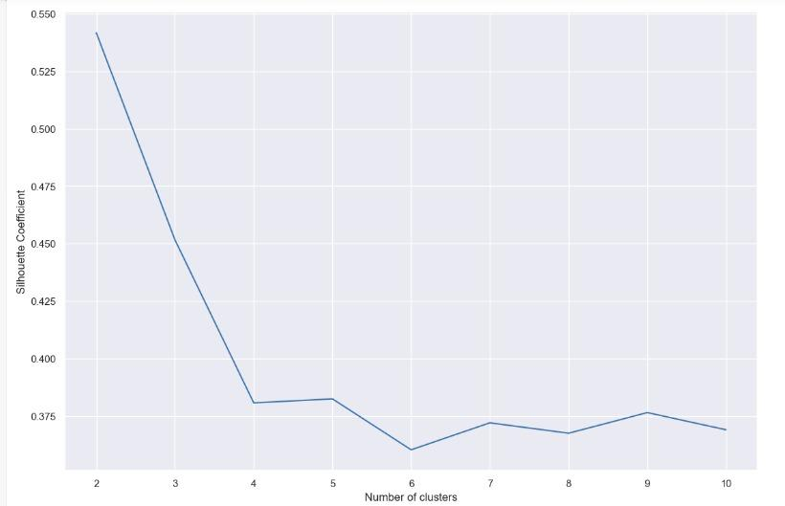
K Means clustering
Silhouette scores used for giving a goodness score

Slide 25
Genre Prediction
Used random forest and Naive Bayes Classifier for Genre Prediction.
Accuracy rate obtained using KNN is 56.9%, whereas for Random Forest 59.6%

